Slide 1

Arabic learner corpus considerations
Anthony Verardi
University of Pittsburgh
LING 2340 Spring 2020
Data Science for Linguists
Dr. Jevon Heath
Full project available at https://github.com/Data-Science-for-Linguists-2020/Arabic-Learner-Corpus-Considerations
Notes:
Hello and welcome to my presentation of my course project “Arabic Learner Corpus Considerations” as a part of Data Science for Linguists at the University of Pittsburgh.

Slide 2
Overview
I. Introduction
Motivation
II. The Arabic Learner Corpus
III. Areas of Investigation
IV. Data Organization
V. Preliminary Analysis
VII. Works Referenced
Learner subgroups
XML and BeautifulSoup
Why Arabic?
Why a learner corpus?
Availability and Licensing
Composition
Support Vector L1 Classifier
Building a DataFrame
Literature Review
Arabic as an L2
Cleaning, Exploratory Data Analysis (EDA)
Collapsing L1 Data
Subgroup Visualizations (WIP)
SVC L1 Classifier
VI. Conclusion
Limitations
Preliminary Findings
Future Directions

Slide 3
Introduction
Section I

Slide 4
Motivation: why Arabic?
Modern Standard Arabic (MSA) and dialectal varieties of Arabic remain understudied in both Computational Linguistics and Second Language Acquisition (SLA)
Personal background as both an L2 Arabic learner and instructor
While Arabic-language corpora exist, their quality is often dubious or they are confined to a highly specific domain (Zaghouani, 2014)

Slide 5
Motivation: why a learner corpus?
Learner corpora are even more rare in the grand scheme of freely-available Arabic corpora
The curators of the present corpus make a number of claims about its potential for use in SLA research and pedagogical applications
Seems like good science in general to explore and evaluate a resource before going ahead with using it to inform classroom or curricular interventions

Slide 6
Literature review: Arabic as an L2
Dearth of reputable, peer-reviewed research on Arabic as a second language
Alhawary (2009) did look at Arabic learner morphosyntactic acquisition in MSA
In general (see Alhawary (Ed.), 2018), works on Arabic as an L2 disproportionately investigate MSA as opposed to spoken dialect
Current project continues in this vein, but at least uses actual data from learners in an educational context and not only NS data

Slide 7
The Arabic Learner corpus
Section II

Slide 8
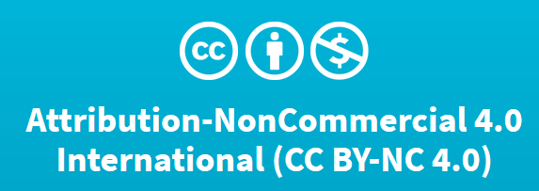
Availability and Licensing
Downloadable in both XML and .txt file formats
English or Arabic metadata
Audio data also available as well as handwritten sheets
POS-tagged .txt and XML files also available
Freely available under a Creative Commons License Attribution-NonCommercial 4.0 International (CC BY-NC 4.0).

Slide 9
Composition
1,585 XML files and a README file about the corpus
“The ALC data has been captured in 2012 and 2013. It includes 282,732 words, 1585 materials (written and spoken), produced by 942 students from 67 nationalities, and 66 different L1 backgrounds. Average length of a text is 178 words” (Alfaifi, Atwell, & Hedaya, 2014)
Two portions to each file:
Metadata about the participant
Text of the response to a prompt (either narrating a vacation trip or describing their studies) and metadata about the response (time on task, dictionary use, etc.)

Slide 10
Areas of investigation
Section III

Slide 11
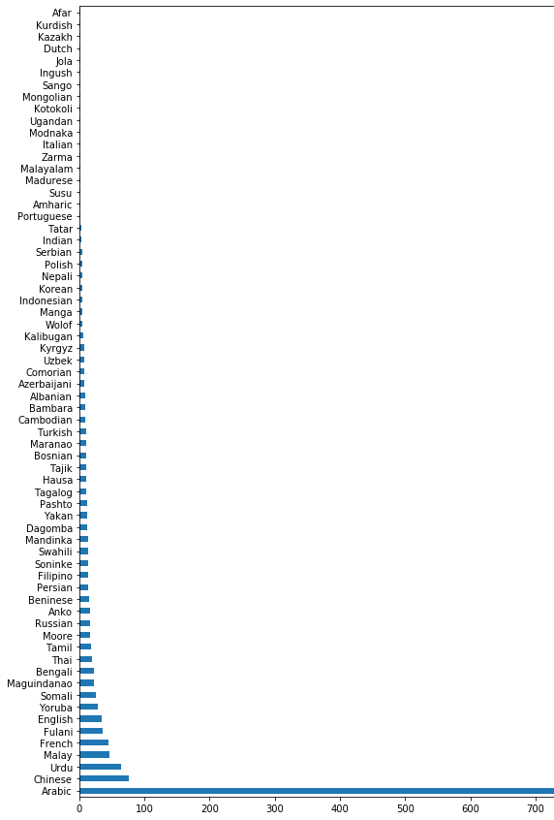
Learner subgroups
Certain assumptions need to be met to determine what kinds of inferential statistical tests can be safely used
Initial run: response counts by L1
Balanced? I think not. How can we improve this?

Slide 12
Support vector l1 classifier
Can these data be used to train a classifier to identify L1?
Is there enough data for Contrastive Interlanguage Analysis (CIA)?
Are the responses unique enough to tell apart, given that their average length is relatively short even for Arabic (~178 words)
What effect do the imbalances in group size have on classification training? We’ve mostly worked in class with data that is relatively balanced

Slide 13
Data organization
Section IV

Slide 14
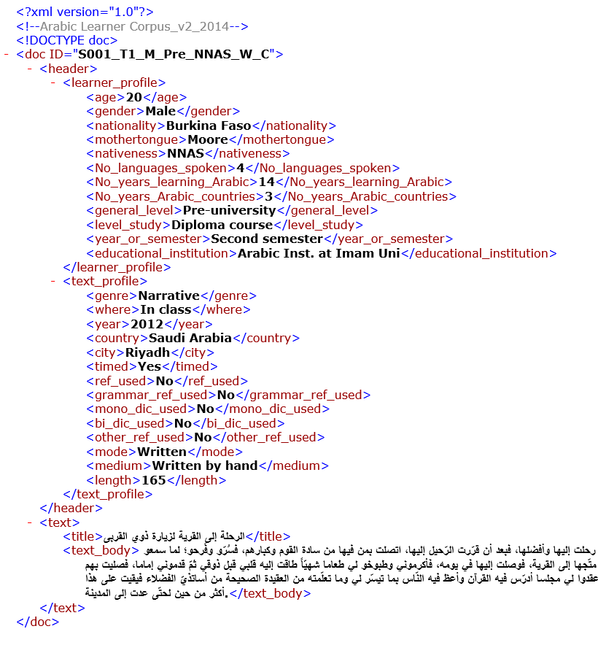
XML and beautifulsoup
XML markup structured as shown on the right
Docs marked with a unique ID, then separated into learner profile, text profile, and text
Structure cuts down the amount of work needed to grab relevant data
BeautifulSoup can be used to import XML and access tagged content

Slide 15
Building a dataframe
Wrote a script that iterated through each file, pulling the following info from the XML and inserting it into a DataFrame:
DocID (the name of the original response document, to be used as an index value later)
L1 (renamed from "Mothertongue" in the original markup; comprised of 66 L1s total)
NumLangs (number of languages known by the participant, ranging from 1-10)
Nationality
Age
Gender
YearsStudy (years studying Modern Standard Arabic)
GenLvl (whether a participant's academic career was pre-university or university)
LvlStdy (Secondary school, language course, diploma course, BA, or MA)
Title (of the response)
Text (of the response)
Genre (narrative or discussion)
Mode (written or spoken)

Slide 16
Building a dataframe
Thankfully, text direction was preserved while building the data frame!
Arabic is written from right to left, so some concern here
Specifying UTF-16 encoding worked just fine
End result: 1585x12 DataFrame ready to rock and roll

Slide 17
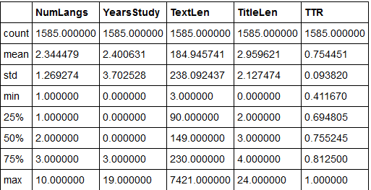
Cleaning, EDA
Cleaning involved:
Filling in NaN values in essay titles
Renaming some problematic column titles
ex. MotherTongue -> L1
Adding in my own calculations for text/title length and TTR (chose not to use pre-counted ones)
Collapsing L1 data into language families (more on next slide)
Post-cleaning, ran a .describe() command to get some descriptive statistics on numerical columns

Slide 18
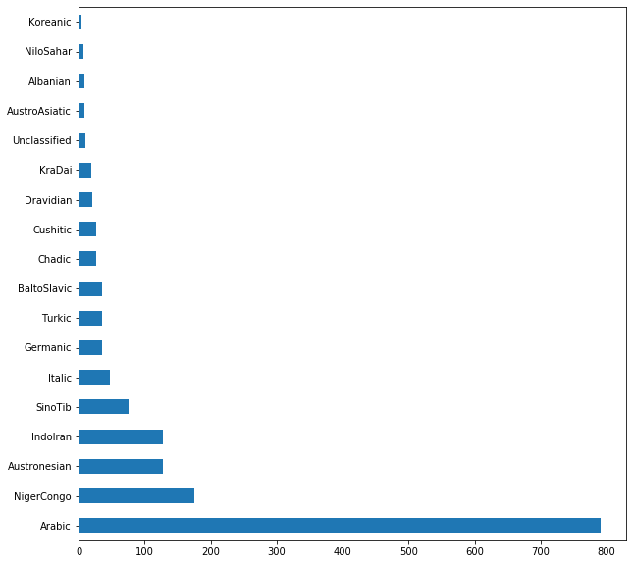
Collapsing l1 data
Value Counts of L1 Families in Arabic Learner Corpus
Biggest organization task: collapsing single languages into macro-families
L1 data alone all over the place (see slide 11)
Additionally, some concerns with certain language names (“Moore”, “Ugandan”, “Modnaka”)
How to collapse Indo-European? Split into one sub-family down from there
Consulted Ethnologue for family info
Turned 66 L1s into 18 families, including one “Unclassified” family for anything that would still only have <5 observations as a category

Slide 19
Preliminary Analysis
Section V

Slide 20
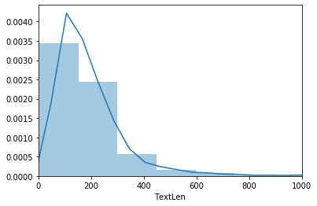
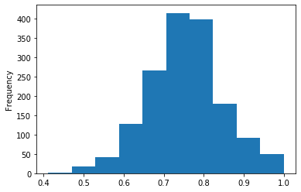
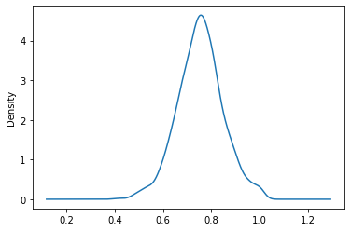
Subgroup visualizations (wip)
Clockwise from top left corner: Text length histogram+ density plot, TTR density plot, and TTR histogram
End goal: text length and TTR distributions as boxplots by L1 family
For now: histogram and density plots of overall dataset for both
Text length skews right
TTR actually pretty normal
For inferential stats, non-parametric test for full data TextLength/maybe log transform, parametric probably fine for TTR

Slide 21
SVC l1 Classifier
Using SVC model and TfIdf Vectorizer in a pipeline
Fine-tuning parameters with Gridsearch CV: trying different max features, min doc frequency, and max doc frequency
Best parameters:
{'tfIdf__max_df': 0.75, 'tfIdf__max_features': 5000, 'tfIdf__min_df': 2}
Using a 20% random testing split after tuning another SVC model with aforementioned parameters
Overall accuracy: 65.62%
How to interpret?
Base probability: Arabic L1 “family” has a much higher base probability in the data than anything else (~49%); chance of randomly drawing an “Arabic” sample is about 50/50
Doesn’t seem to be doing too great when considering that in an evenly split dataset (ETS), our classifiers got up to around 70-75% with a base probability of ~10%
Looks like unevenness of data plays a big role—how to qualify?

Slide 22
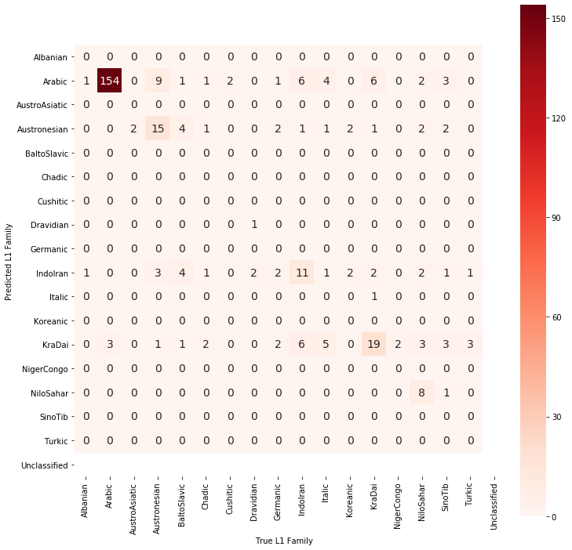
SVC L1 Classifier
Taking a close look at output of classifier using a confusion matrix
Classifier correctly labels ALL true Arabic samples as Arabic, good job there
Other groups not doing so hot: sometimes fails to classify ANY correctly, other times gets maybe 65-75% right in a family

Slide 23
Conclusion
Section VI

Slide 24
Limitations
Have not accounted for other types of grouping factors within my analysis or included other factors in my model besides actual text
There are not 1,585 participants, there are 942; not all participants did all tasks
This can also impact what inferential tests are appropriate to use
Worried that collapsing the data any further into L1 + only written examples would leave too little to work with for ML
Lots of additional data to work with, need to figure out feature union
Some doubts about whether I’m operationalizing “usefulness” fairly in constructing this argument
If collapsing further into Arabic native speaker vs. Arabic learner is helpful, is that so bad? On the other hand, what are we losing in generalizability by collapsing so many different L1 families together?

Slide 25
Preliminary Findings
Limitations considered, I think some serious doubts remain about what kinds of questions this dataset can be used to explore
Contrastive Interlanguage Analysis (CIA) probably best done on relatively equal groups like the ETS corpus (would love a citation here; need to do some research)
When considering what questions are fair to even explore with a dataset, knowing what you’re actually dealing with and not just taking the set for granted are necessary
That being said, highlights difficulties of working with under-researched languages, and I’m not blaming the authors for any shortcomings—it’s amazing that they’ve even made this and made it public and I thank them for their work

Slide 26
Future Directions
In short: finishing up!
Breaking out learner groups and visualizing text length/TTR distributions by L1 family
Trying another go at a classifier with only native Arabic/non-native Arabic as labels

Slide 27



شكرا كتير كتير!

Slide 28
Works referenced
Alfaifi, A., Atwell, E. and Hedaya, I. (2014). Arabic Learner Corpus (ALC) v2: A New Written and Spoken Corpus of Arabic Learners. In the proceedings of the Learner Corpus Studies in Asia and the World (LCSAW) 2014, 31 May - 01 Jun 2014. Kobe, Japan. <>.
Alhawary, M. T. (2009). Arabic Second Language Acquisition of Morphosyntax. New Haven, United States: Yale University Press.
Alhawary, M. T. (Ed.) (2018). Routledge Handbook of Arabic Second Language Acquisition (1 ed.). London: Routledge.
Zaghouani, Wajdi. (2014) Critical Survey of the Freely Available Arabic Corpora. Published in the Proceedings of the International Conference on Language Resources and Evaluation (LREC'2014), OSACT Workshop. Reykjavik, Iceland, 26-31 May 2014

